Slide 1
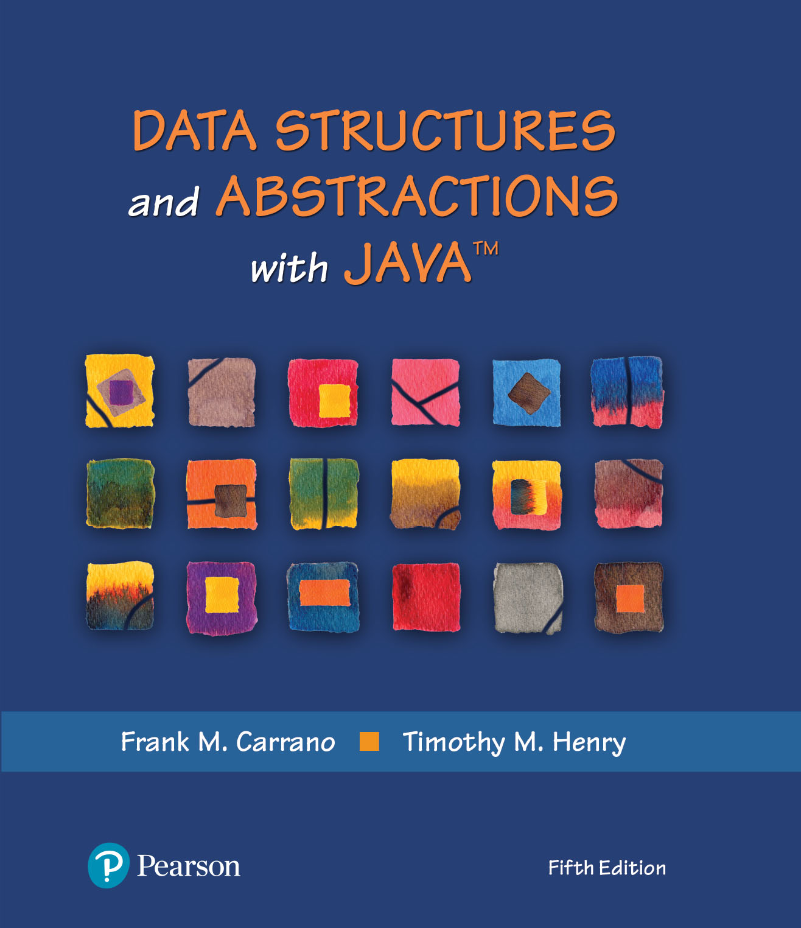
Module 12
Chapter 20 – Dictionaries
Chapter 21 – Dictionary Implementations

Slide 2
Video Notes
ADT Dictionary
https://mediaplayer.pearsoncmg.com/assets/secs-vn-ch20a-the-adt-dictionary
Using ADT Dictionary
https://mediaplayer.pearsoncmg.com/assets/secs-vn-ch20b-using-the-adt-dictionary
Array-Based Dictionary
https://mediaplayer.pearsoncmg.com/assets/secs-vn-ch21a-array-based-adt-dictionaries
Linked-Based Dictionary
https://mediaplayer.pearsoncmg.com/assets/secs-vn-ch21b-link-based-dictionaries

Slide 3

Dictionaries
When you want to look up …
The meaning of a word
An address
A phone number
A contact on your phone
What do they have in common?
These can be implemented in an Dictionary (ADT)
Notes:
What’s the pattern?

Slide 4
Dictionary (ADT) | Specifications
Collection of key-value pairs
Each entry (in the dictionary) contains
Keyword, search key
Value
Synonyms for Dictionary
Map
Look-up Table
Associative array
Notes:
ADT Dictionary (K,V) is the same as Map (K,V)
Abstract class | obsolete | https://docs.oracle.com/javase/8/docs/api/java/util/Dictionary.html // abstract class
Interface | https://docs.oracle.com/javase/8/docs/api/java/util/Map.html
https://www.geeksforgeeks.org/differences-between-hashmap-and-hashtable-in-java/

Slide 5
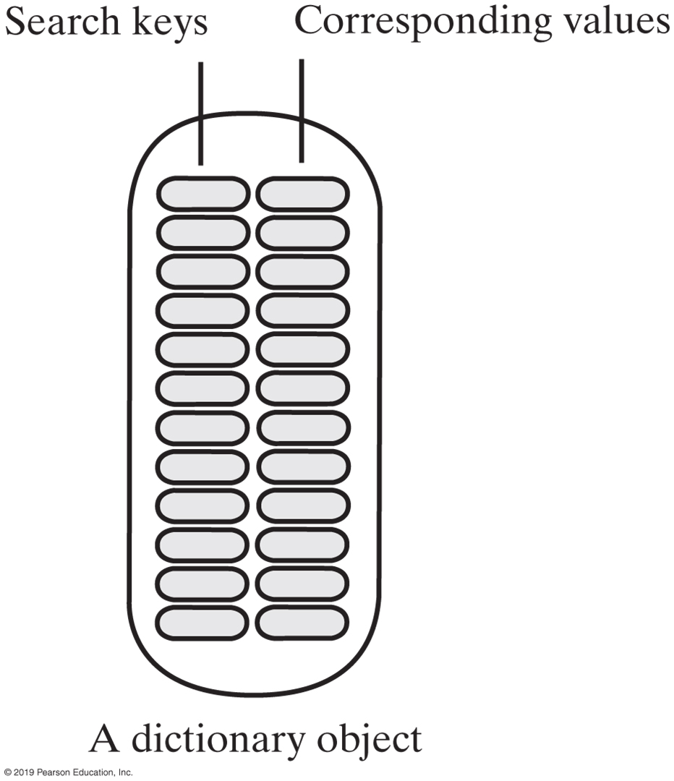
Dictionary | Specifications
Dictionary Data
Collection of pairs (k, v)
k is the search key
v is the corresponding value
Number of pairs in the collection
An instance of the dictionary has search keys paired with corresponding values

Slide 6
Java Interface | Dictionary (Part 1)
/** An interface for a dictionary with distinct search keys.
Search keys and associated values are not null. */
public interface DictionaryInterface<K, V>
{
/** Adds a new entry to this dictionary. If the given search key already
exists in the dictionary, replaces the corresponding value.
@param key An object search key of the new entry.
@param value An object associated with the search key.
@return Either null if the new entry was added to the dictionary
or the value that was associated with key if that value
was replaced. */
public V add(K key, V value);
/** Removes a specific entry from this dictionary.
@param key An object search key of the entry to be removed.
@return Either the value that was associated with the search key
or null if no such object exists. */
public V remove(K key);
/** Retrieves from this dictionary the value associated with a given
search key.
@param key An object search key of the entry to be retrieved.
@return Either the value that is associated with the search key
or null if no such object exists. */
public V getValue(K key);

Slide 7
Java Interface | Dictionary (Part 2)
/** Sees whether a specific entry is in this dictionary.
@param key An object search key of the desired entry.
@return True if key is associated with an entry in the dictionary. */
public boolean contains(K key);
/** Creates an iterator that traverses all search keys in this dictionary.
@return An iterator that provides sequential access to the search
keys in the dictionary. */
public Iterator<K> getKeyIterator();
/** Creates an iterator that traverses all values in this dictionary. @return An iterator that provides sequential
access to the values in this dictionary. */
public Iterator<V> getValueIterator();
/** Sees whether this dictionary is empty.
@return True if the dictionary is empty. */
public boolean isEmpty();
/** Gets the size of this dictionary.
@return The number of entries (key-value pairs) currently in the dictionary. */
public int getSize();
/** Removes all entries from this dictionary. */
public void clear();
} // end DictionaryInterface
Notes:
getKeyIterator();
getValueIterator();

Slide 8
Dictionary (ADT)
Operations
add(key, value)
remove(key)
getValue(key)
contains(key)
getKeyIterator()
getValueIterator()
isEmpty()
getSize()
clear()
NOTE: This class is obsolete. New implementations should implement the Map interface, rather than extending this class
Notes:
https://docs.oracle.com/javase/8/docs/api/java/util/Map.html
https://docs.oracle.com/javase/8/docs/api/java/util/Dictionary.html

Slide 9
Map, Hashtable & HashMap
Inteface Map<K,V>
https://docs.oracle.com/javase/8/docs/api/java/util/Map.html
Class Hashtable<K,V>
Implements a hash table, which maps keys to values. Any non-null object can be used as a key or as a value
https://docs.oracle.com/javase/8/docs/api/java/util/Hashtable.html
Class HashMap<K,V>
This implementation provides all of the optional map operations, and permits null values and the null key
Notes:
https://docs.oracle.com/javase/7/docs/api/java/util/Map.html
https://docs.oracle.com/javase/8/docs/api/java/util/Hashtable.html

Slide 10
Dictionary Iterators
Options for dictionary iterators
Can use each of these iterators either separately or together to traverse:
All search keys in a dictionary without traversing values
All values without traversing search keys
All search keys and all values in parallel
Iterator<String> keyIterator = dataBase.getKeyIterator();
Iterator<Student> valueIterator = dataBase.getValueIterator();

Slide 11
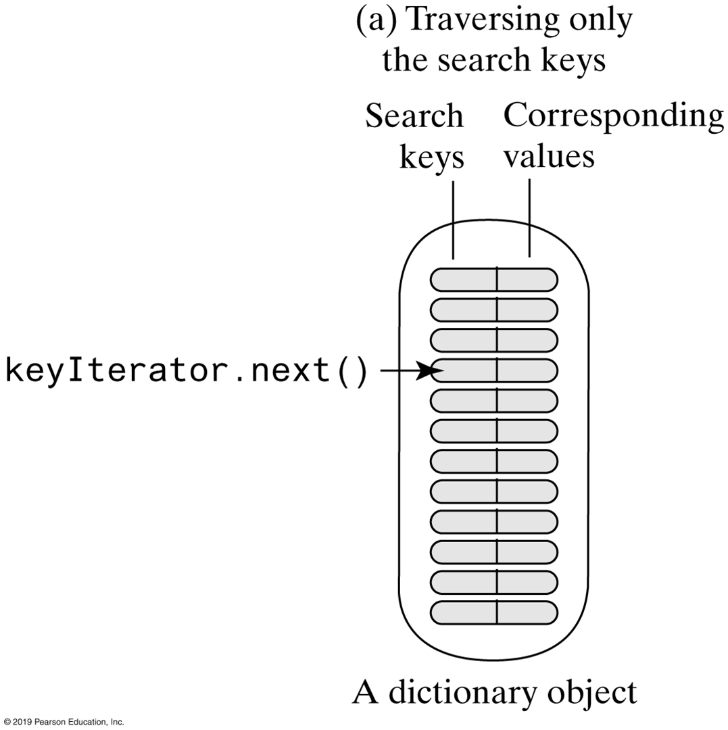
Dictionary Iterators
Traversing a dictionary’s keys separately

Slide 12
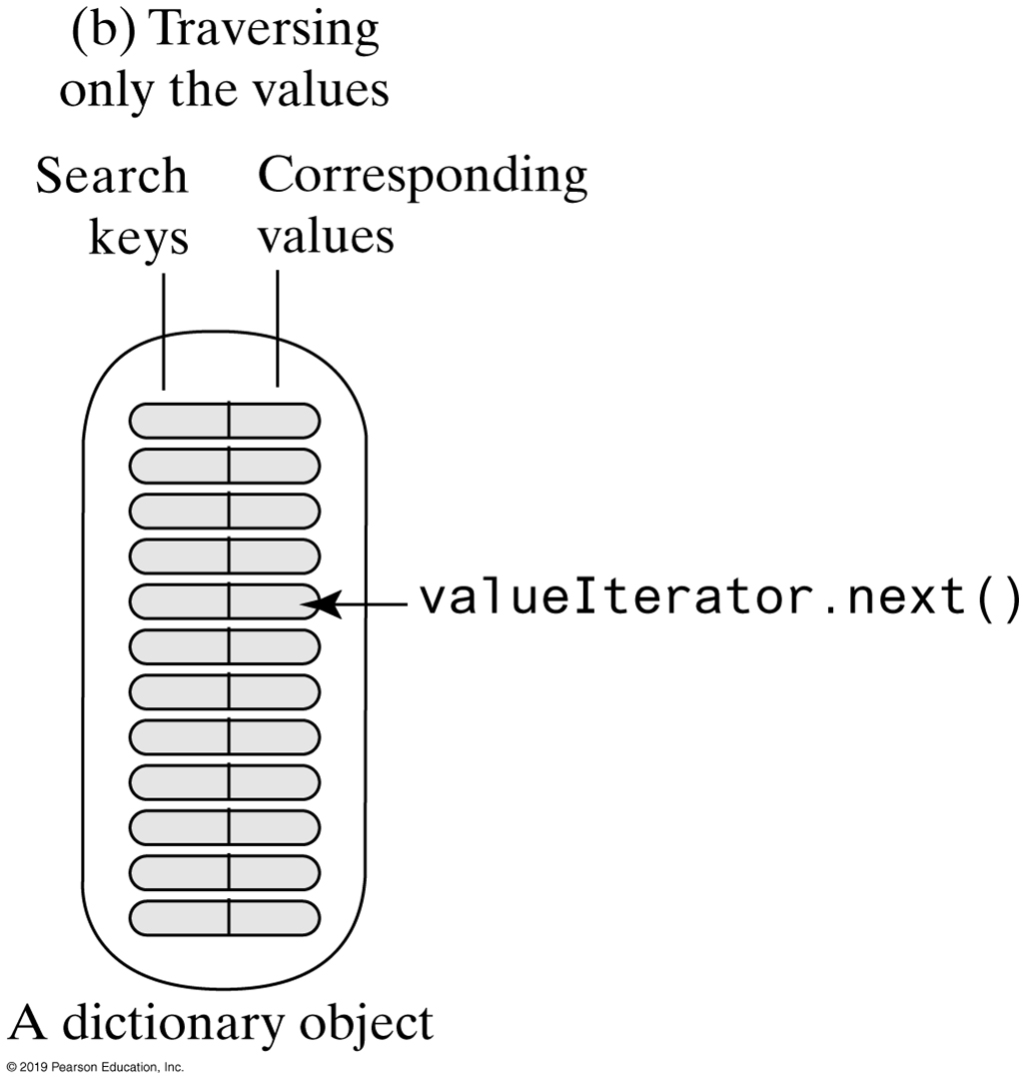
Dictionary Iterators
Traversing a dictionary’s values separately

Slide 13
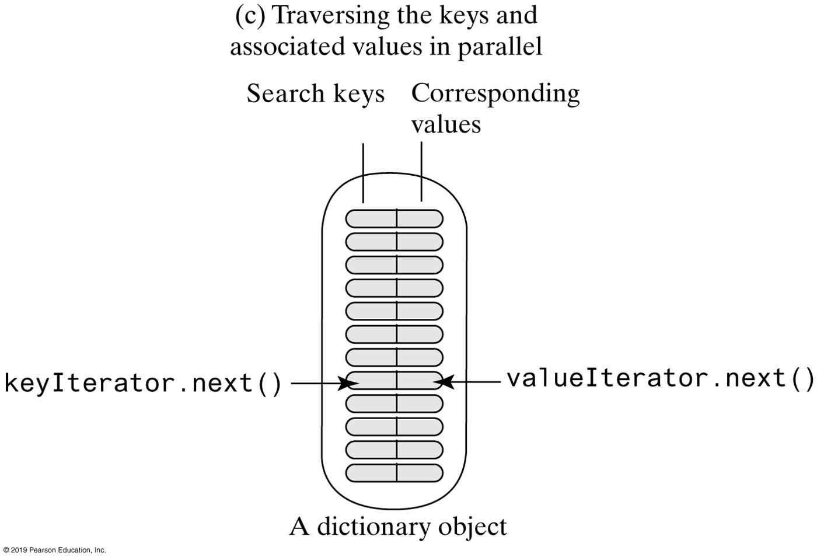
Dictionary Iterators
Two iterators that traverse a dictionary’s keys and values in parallel

Slide 14
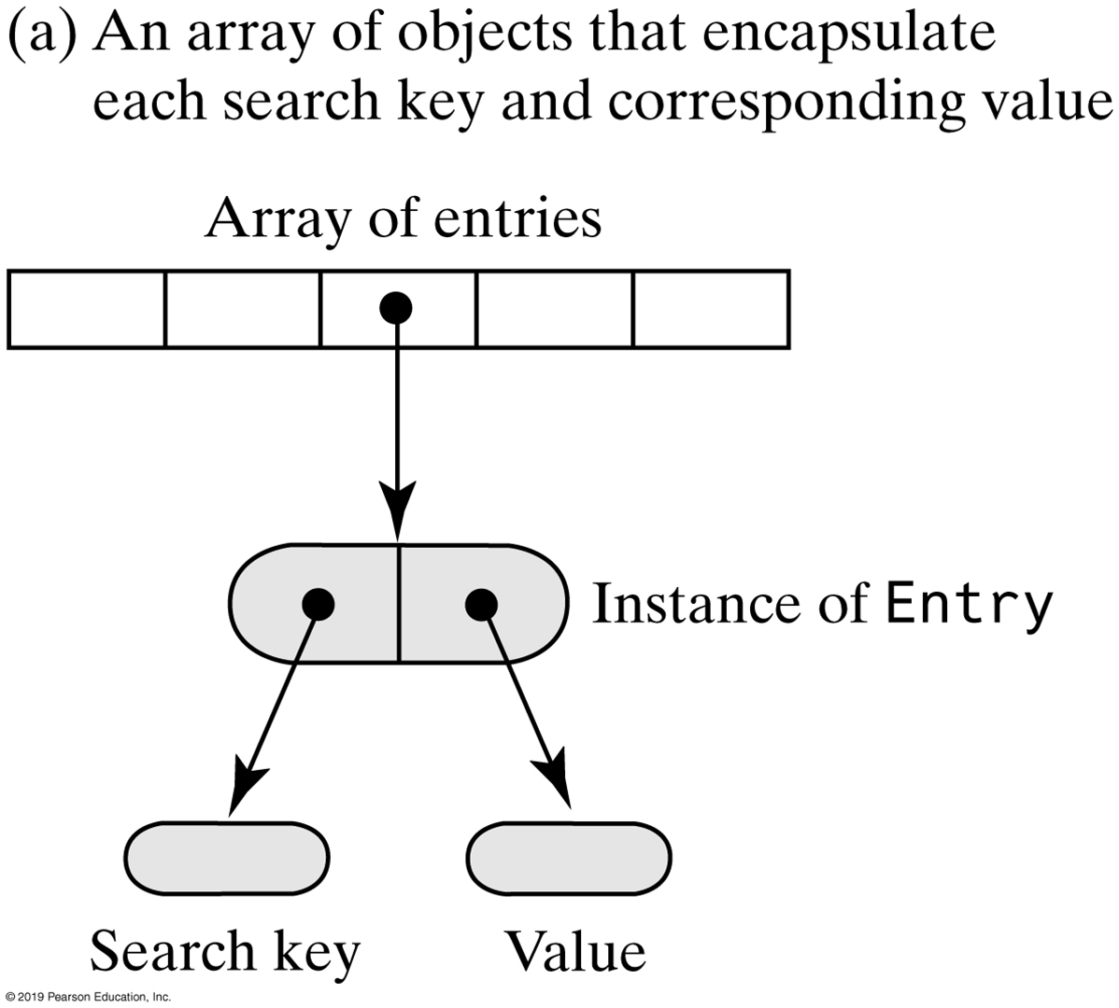
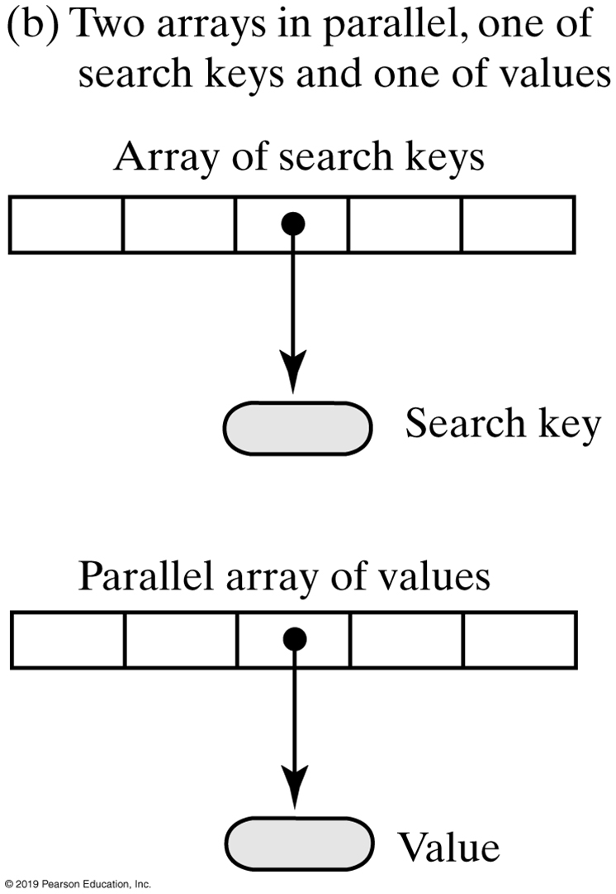
Array-Based Dictionaries
Two possible ways to use arrays to represent the entries in a dictionary
Notes:
Array of entries vs. parallel arrays
(a) is the way to go

Slide 15
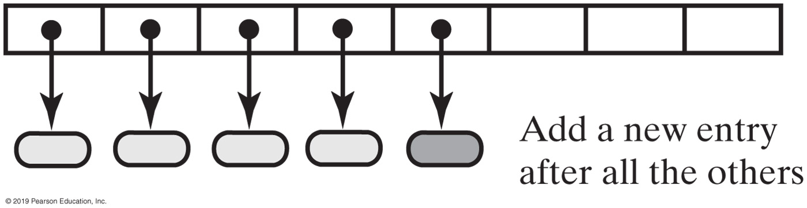
Unsorted Array-Based Implementations
Adding a new entry to an unsorted array-based dictionary

Slide 16
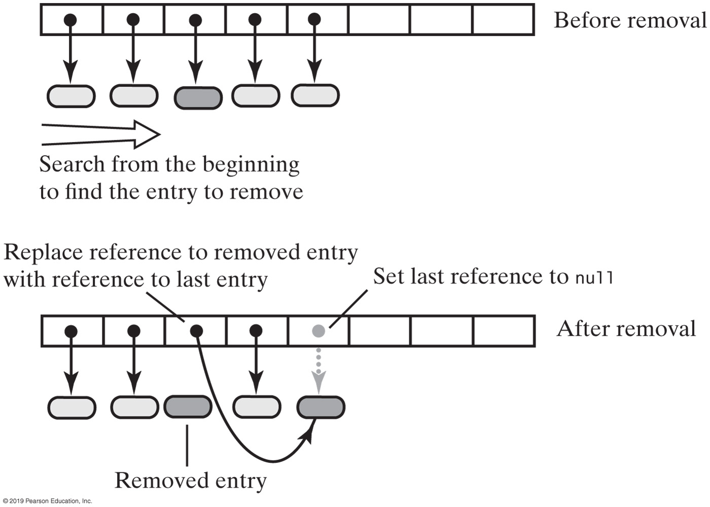
Unsorted Array-Based Implementations
Removing an entry from an unsorted array-based dictionary

Slide 17
Unsorted Array-Based Implementations
For this implementation, worst-case efficiencies of the operations are:
Addition: O(n)
Removal: O(n)
Retrieval: O(n)
Traversal: O(n)

Slide 18
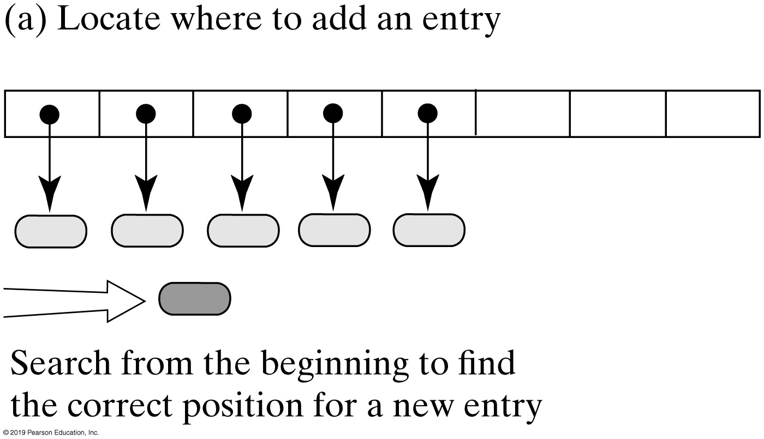
Sorted Array-Based Implementations
Adding an entry to a sorted array-based dictionary
Notes:
Advantage of sorted implementations

Slide 19
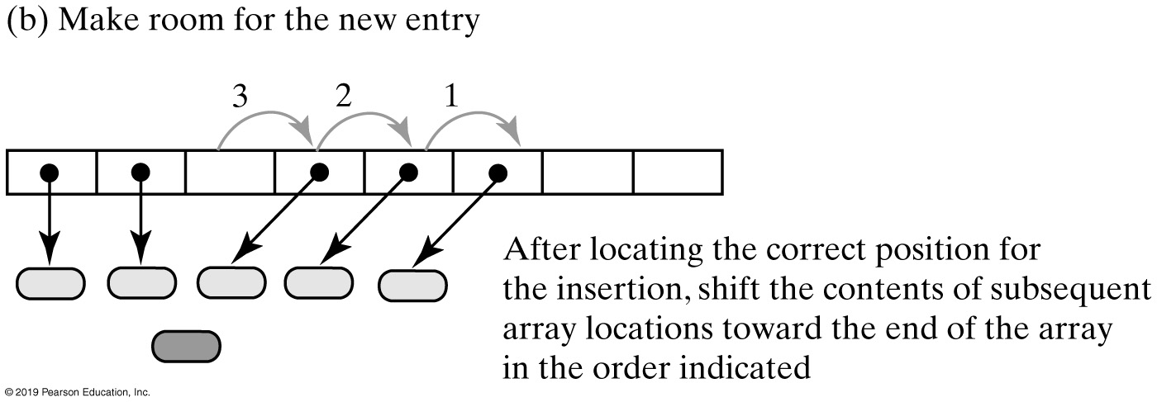
Sorted Array-Based Implementations
Adding an entry to a sorted array-based dictionary
Notes:
What are we relocating?

Slide 20
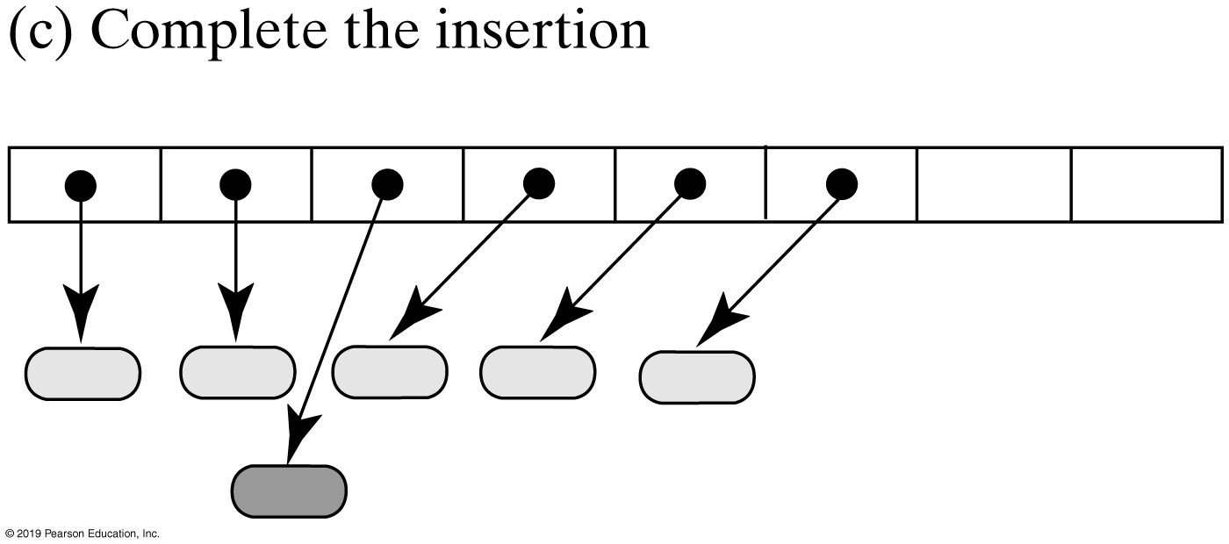
Sorted Array-Based Implementations
Adding an entry to a sorted array-based dictionary

Slide 21
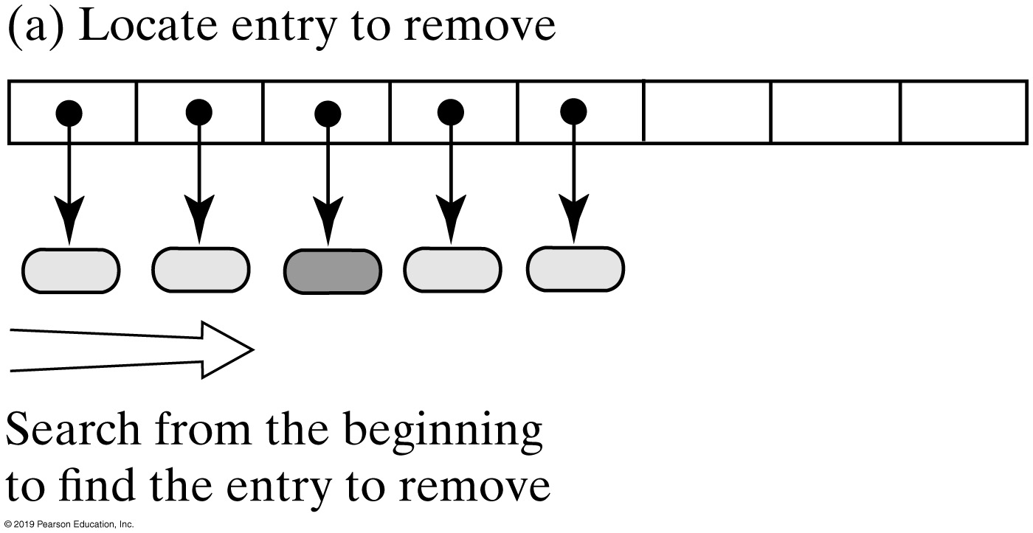
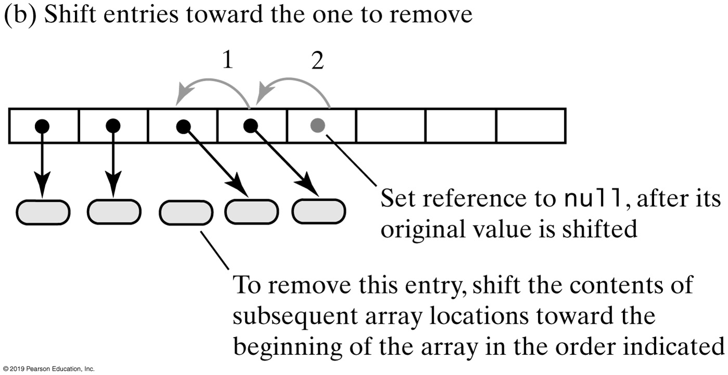
Sorted Array-Based Dictionary
Removing an entry from a sorted array-based dictionary

Slide 22
Sorted Array-Based Dictionary
Efficiency of sorted array-based dictionary
When locateIndex uses a binary search in the sorted array-based implementation, the worst-case efficiencies are:
Addition: O(n)
Removal: O(n)
Retrieval: O(log n)
Traversal: O(n)
Let’s think about this for a second
What are the most important operations?
Notes:
Retrieval is an important aspect for many application. Think Google
O(log n) is good, but can we do better?
What’s better than O(log n)

Slide 23
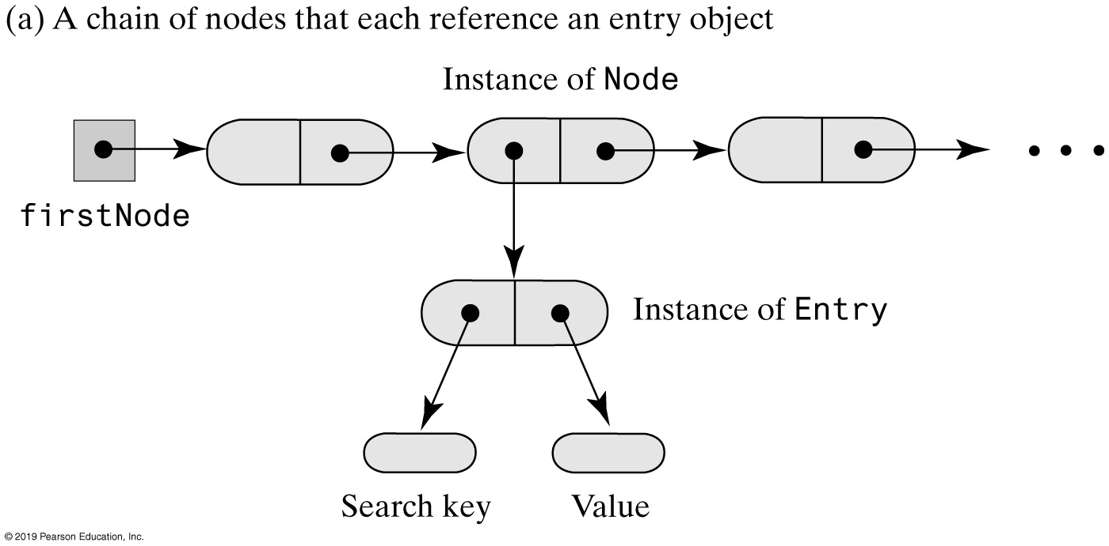
Linked Dictionary Implementations
Representing the entries in a dictionary

Slide 24
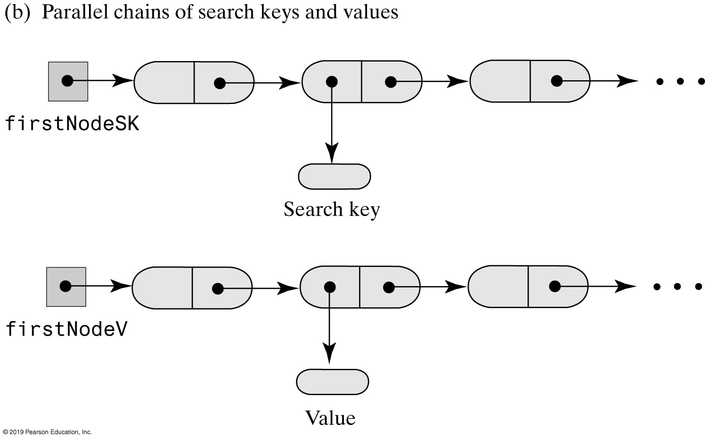
Linked Dictionary Implementations
Representing the entries in a dictionary
Notes:
Should we even consider this approach?

Slide 25
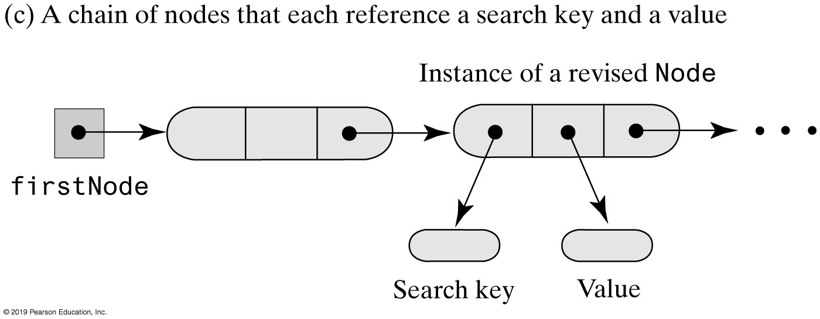
Linked Dictionary Implementations
Representing the entries in a dictionary

Slide 26
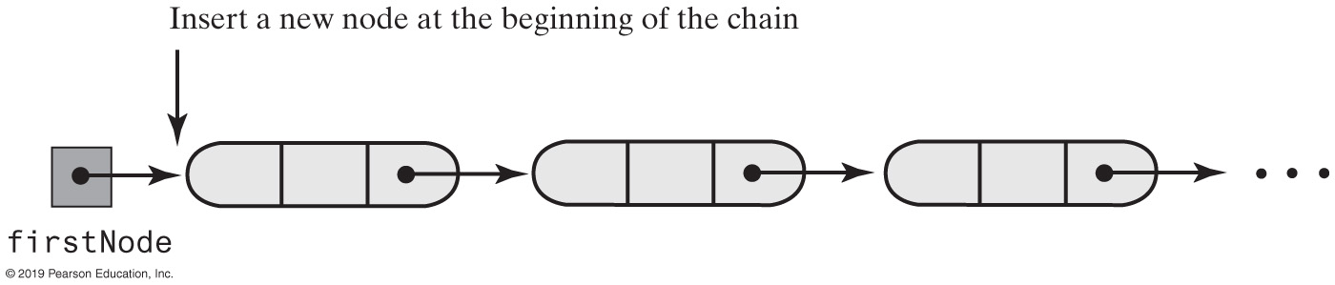
Unsorted Linked Dictionary
Adding to Unsorted Linked Dictionary

Slide 27
An Unsorted Linked Dictionary
Efficiency of an unsorted linked dictionary:
The worst-case efficiencies of the operations
Addition: O(1)
Removal: O(1)
Retrieval: O(n)
Traversal: O(n)
Notes:
Is there an application for unsorted linked?

Slide 28
Sorted Linked Dictionary
Efficiency of a sorted linked dictionary:
The worst-case efficiencies of the operations
Addition: O(n)
Removal: O(n)
Retrieval: O(n)
Traversal: O(n)
Notes:
Why is Retrieval O(n), even for a sorted linked dictionary?

Slide 29
Sorted Linked Dictionary (1 of 3)
/** A class that implements the ADT dictionary by using a chain of linked nodes.
The dictionary is sorted and has distinct search keys.
Search keys and associated values are not null. */
public class SortedLinkedDictionary<K extends Comparable<? super K>, V>
implements DictionaryInterface<K, V>
{
private Node firstNode; // Reference to first node of chain
private int numberOfEntries;
public SortedLinkedDictionary()
{
initializeDataFields();
} // end default constructor
private class Node
{
private K key;
private V value;
private Node next;
/* Constructors and the methods getKey, getValue, setValue, getNextNode,
and setNextNode are here. There is no setKey.
. . . */
} // end Node
} // end SortedLinkedDictionary

Slide 30
Sorted Linked Dictionary (2 of 3)
public V add(K key, V value)
{
V result = null;
if ((key == null) || (value == null))
throw new IllegalArgumentException("Cannot add null to a dictionary.");
else
{
// Search chain until you either find a node containing key
// or locate where it should be
Node currentNode = firstNode;
Node nodeBefore = null;
while ( (currentNode != null) && (key.compareTo(currentNode.getKey()) > 0))
{
nodeBefore = currentNode;
currentNode = currentNode.getNextNode();
} // end while
if ( (currentNode != null) && key.equals(currentNode.getKey()) )
{
// Key in dictionary; replace corresponding value
result = currentNode.getValue(); // Get old value
currentNode.setValue(value); // Replace value
}
else // Key not in dictionary; add new node in proper order

Slide 31
Sorted Linked Dictionary (3 of 3)
{
// Assertion: key and value are not null
Node newNode = new Node(key, value); // Create new node
if (nodeBefore == null)
{ // Add at beginning (includes empty chain)
newNode.setNextNode(firstNode);
firstNode = newNode;
}
else // Add elsewhere in non-empty chain
{
newNode.setNextNode(currentNode); // currentNode is after new node
nodeBefore.setNextNode(newNode); // nodeBefore is before new node
} // end if
numberOfEntries++; // Increase length for both cases
} // end if
} // end if
return result;
} // end add

Slide 32
Implementation Comparison
Operation | Array-based Unsorted | Array-based Sorted | Linked Unsorted | Linked Sorted
Addition | O(n) | O(n) | O(1) | O(n)
Removal | O(n) | O(n) | O(1) | O(n)
Retrieval | O(n) | O(log n) | O(n) | O(n)
Traversal | O(n) | O(n) | O(n) | O(n)
Sorted vs. unsorted data
Notes:
What’s the most important operation(s)?

Slide 33
The Interface Map (Java Class Library)
public V put(K key, V value);
public V remove (Object key);
public V get(Object key);
public boolean containsKey(Object key);
public boolean containsKey(Object value);
public Set<K> keySet();
public Collection<V> values();
public boolean isEmpty();
public int size();
public void clear();
Method headers for a selection of methods in Map
Highlighted methods differ from our method implementations

Slide 34
Example
Telephone Numbers Directory
Using the Dictionary | Video Note

Slide 35
Telephone Numbers Directory
Program Output
Enter first name and last name or quit to end: Maria Lopez
The phone number for Maria Lopez is 401-555-1234
Enter first name and last name or quit to end: Hunter
Error in entering name. Try again.
Enter first name and last name or quit to end: Hunter Smith
Hunter Smith is not in the directory.
Enter first name and last name or quit to end: quit
Bye!
Sample Testing Output

Slide 36
Using a Dictionary
TelephoneDirectory
phoneBook
readFile(data) getPhoneNUmber(name)
1
Dictionary
*
Name
1
*
*
*
String
A class diagram for a telephone directory
Notes:
Class Name

Slide 37
Class Telephone Directory
/** A class of telephone directories. */
public class TelephoneDirectory
{ // Sorted dictionary with distinct search keys
private DictionaryInterface<Name, String> phoneBook;
public TelephoneDirectory()
{
phoneBook = new SortedDictionary<>();
} // end default constructor
Class TelephoneDirectory Constructor

Slide 38
Method getPhoneNumber()
/** Gets the phone number of a given person. */
public String getPhoneNumber(Name personName)
{
return phoneBook.getValue(personName);
} // end getPhoneNumber
public String getPhoneNumber(String firstName, String lastName)
{
Name fullName = new Name(firstName, lastName);
return phoneBook.getValue(fullName);
} // end getPhoneNumber
} // end TelephoneDirectory

Slide 39
Example | Frequency of Words
/** A driver that demonstrates the class FrequencyCounter. */
public class Driver
{
public static void main(String[] args)
{
FrequencyCounter wordCounter = new FrequencyCounter();
String fileName = "Data.txt"; // Or file name could be read
try
{
Scanner data = new Scanner(new File(fileName));
wordCounter.readFile(data);
}
catch (FileNotFoundException e)
{
System.out.println("File not found: " + e.getMessage());
}
wordCounter.display();
} // end main
} // end Driver
Notes:
How do you track the frequency (count) of a word in a file?

Slide 40
Class FrequencyCounter (1 of 3)
/** A class that counts the number of times each word occurs in a document. */
public class FrequencyCounter
{
private DictionaryInterface<String, Integer> wordTable;
public FrequencyCounter()
{
wordTable = new SortedDictionary<>();
} // end default constructor
Notes:
How do you track the frequency (count) of a word in a file?

Slide 41
Class FrequencyCounter (2 of 3)
/** Reads a text file of words and counts their frequencies of occurrence.
@param data A text scanner for the text file of data. */
public void readFile(Scanner data)
{
data.useDelimiter("\\W+");
while (data.hasNext())
{
String nextWord = data.next();
nextWord = nextWord.toLowerCase();
Integer frequency = wordTable.getValue(nextWord);
if (frequency == null)
{ // Add new word to table
wordTable.add(nextWord, new Integer(1));
}
else
{ // Increment count of existing word; replace wordTable entry
frequency++;
wordTable.add(nextWord, frequency);
} // end if
} // end while
data.close();
} // end readFile
The method readFile of class FrequencyCounter

Slide 42
Class FrequencyCounter (3 of 3)
/** Displays words and their frequencies of occurrence. */
public void display()
{
Iterator<String> keyIterator = wordTable.getKeyIterator();
Iterator<Integer> valueIterator = wordTable.getValueIterator();
while (keyIterator.hasNext())
{
System.out.println(keyIterator.next() + " " + valueIterator.next());
} // end while
} // end display
} // end FrequencyCounter
The method display of class FrequencyCounter

Slide 43
A Concordance of Words (1 of 3)
A concordance provides location (page or line number) of word
/** A class that represents a concordance. */
public class Concordance
{
private DictionaryInterface<String,
ListWithIteratorInterface<Integer>> wordTable;
public Concordance()
{
wordTable = new SortedDictionary<>();
} // end default constructor

Slide 44
A Concordance of Words (2 of 3)
/** Reads a text file of words and creates a concordance.
public void readFile(Scanner data) {
int lineNumber = 1;
while (data.hasNext())
{
String line = data.nextLine();
line = line.toLowerCase();
Scanner lineProcessor = new Scanner(line);
lineProcessor.useDelimiter("\\W+");
while (lineProcessor.hasNext())
{
String nextWord = lineProcessor.next();
ListWithIteratorInterface<Integer> lineList = wordTable.getValue(nextWord);
if (lineList == null)
{ // Create new list for new word; add word and list to index
lineList = new LinkedListWithIterator<>();
wordTable.add(nextWord, lineList);
} // end if
// Add line number to end of list so list is sorted
lineList.add(lineNumber);
} // end while
lineNumber++;
} // end while
data.close();
} // end readFile
The method readFile of class Concordance

Slide 45
A Concordance of Words (3 of 3)
/** Displays words and the lines in which they occur. */
public void display()
{
Iterator<String> keyIterator = wordTable.getKeyIterator();
Iterator<ListWithIteratorInterface<Integer>> valueIterator =
wordTable.getValueIterator();
while (keyIterator.hasNext())
{
// Display the word
System.out.print(keyIterator.next() + " ");
// Get line numbers and iterator
ListWithIteratorInterface<Integer> lineList = valueIterator.next();
Iterator<Integer> listIterator = lineList.getIterator();
// Display line numbers
while (listIterator.hasNext())
{
System.out.print(listIterator.next() + " ");
} // end while
System.out.println();
} // end while
} // end display
} // end Concordance
The method display of class Concordance

